Slide 1
Industry Pulse:
Trends in Functional Verification
Harry Foster
Chief Scientist Verification
Design Verification Technology
MemoCODE 2013
Notes:
Good morning, and welcome to today’s seminar. We have some interesting talks lined up that I think you are going to enjoy.
Now, I’ve titled my talk “Beyond Theory, Standards, and the Status Quo.” What I hope to do this morning is show you an emerging trend in terms of accelerated rate in which traditional system-level functionality is being integrated into a single SoC.
To address this increasing complexity brought on by higher levels of integration, the industry has been forced to adopt more holistic design and verification flows.
For example, it is no longer sufficient to simply track coverage purely at the IP-level—ignoring other interactions related to software and power.
My plan is to present to you recent trends that have shaped today's emerging SoC flows, and my claims are that we are now beyond theory in terms of rising complexity, beyond arguing over who won the standards wars, and beyond surviving by maintaining the status quo.

Slide 2
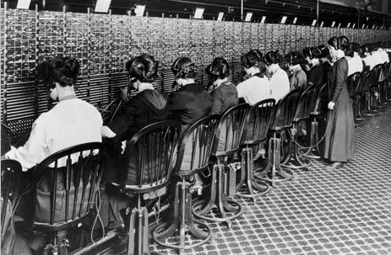
Extrapolating From Current Conditions Disregards Future Innovation
“In 1910, in the early history telephony, a Bell telephone statistician projected a massive ramp-up in switchboard operator jobs as telephone use grew, until “every woman in America” would be required.”
Source: Future Savvy: Identifying trends to Make Better Decisions, Manage Uncertainty, and Profit From Change Adam Gordon, 2008
Notes:
“This forecast projected the rapidly growing telephone service, therefore a growing demand for live operators, but missed automated switching, which fundamentally changed the need for live operators. Automated switching was the new factor, the trend breaker. It fundamentally changed the validity of the assumption on which the extrapolation rested, no doubt to the surprise of the forecaster and everyone who based his or her thinking or financial or technology investments on this forecast.”

Slide 3
Functional Verification Market
According to EDAC
38% Growth Between 2010 2012
EDAC: Market Statistics Service 2007 Annual Summary Report
Notes:
Logic Verification + Formal property checking:
2010: 139.6 + 153.1 + 171.1 + 180.0 = 653.8
2010: 8.4 + 9.4 + 12.1 + 14.0 = 44.9 (Formal Property Checking)
2012: 200.2 + 226.7 + 229.3 + 249.9 = 906.1 (nearly 39% growth over 2 years)
2012: 12.4 + 12.9 + 17.5 + 15.8 = 58.6 (Formal Property Checking – 31% growth)
2010 combined: 698.7 (5-6% of total market share)
2012 combined: 964.7 (38% growth rate)
Include Formal
2010: 33
2012: 50
RTL Simulation:
2010: 84.5 + 88.6 + 99.2 + 107.3 = 379.6 (54% of the logic verification market)
2012: 103.2 + 102.7 + 106.0 + 116.3 = 428.2 (13% growth – 1/3 growth of LV market)
(44% of LV market – lost of 11 percentage points of market share!)
HW Assisted Verification:
2010: 38.0 + 48.6 + 53.7 + 47.4 = 187.7 (27% of logic verification market) (NOTE: Sim + HW assisted = 81% of LV market, rounding error)
2012: 74.1 + 98.6 + 97.1 + 93.6 = 363.4 (94% growth – 2.6x faster than growth of LV market)
(38% of LV market) (NOTE: Sim + HW assisted = 82% of LV market STILL)

Slide 4
Functional Verification Market
According to EDAC
EDAC: Market Statistics Service 2007 Annual Summary Report
Notes:
Logic Verification + Formal property checking:
2010: 139.6 + 153.1 + 171.1 + 180.0 = 653.8
2010: 8.4 + 9.4 + 12.1 + 14.0 = 44.9 (Formal Property Checking)
2012: 200.2 + 226.7 + 229.3 + 249.9 = 906.1 (nearly 39% growth over 2 years)
2012: 12.4 + 12.9 + 17.5 + 15.8 = 58.6 (Formal Property Checking – 31% growth)
2010 combined: 698.7 (5-6% of total market share)
2012 combined: 964.7 (38% growth rate)
Include Formal
2010: 33
2012: 50
RTL Simulation:
2010: 84.5 + 88.6 + 99.2 + 107.3 = 379.6 (54% of the logic verification market)
2012: 103.2 + 102.7 + 106.0 + 116.3 = 428.2 (13% growth – 1/3 growth of LV market)
(44% of LV market – lost of 11 percentage points of market share!)
HW Assisted Verification:
2010: 38.0 + 48.6 + 53.7 + 47.4 = 187.7 (27% of logic verification market) (NOTE: Sim + HW assisted = 81% of LV market, rounding error)
2012: 74.1 + 98.6 + 97.1 + 93.6 = 363.4 (94% growth – 2.6x faster than growth of LV market)
(38% of LV market) (NOTE: Sim + HW assisted = 82% of LV market STILL)

Slide 5

2012 Wilson Research Group
Functional Verification Study
Conducted by Wilson Research Group
  Commissioned by Mentor Graphics
  Format followed 2002, 2004 Collett studies for trend analysis, as well as the 2007 FarWest Research Study
Worldwide study
  Overall confidence of 95% plus/minus 4.05%
This was a blind study!
  To eliminate any bias in the results
This was a balanced study!
  No single vendor dominated responses
Wilson Research Group

Slide 6
Who Participated In The Survey
Participant’s market segment
Wilson Research Group and Mentor Graphics, 2012 Functional Verification Study, Used with permission

Slide 7
Who Participated In The Survey
Participant’s job title
Wilson Research Group and Mentor Graphics, 2012 Functional Verification Study, Used with permission

Slide 8

Overview
Beyond Theory
Beyond Standards
Beyond the Status Quo

Slide 9
Beyond Theory
Beyond Theory in Terms of Rising Complexity
Notes:
I want to begin by explaining what I mean by “Beyond theory in terms of rising complexity.” Let’s talk about theory a minute.

Slide 10
Difference Between Theory and Practice
In theory there is no difference between theory and practice, but in practice there is.
Notes:
And specifically, I want to discuss the difference between theory and practice.
Now, in theory there is no difference between theory and practice, but in practice there is.
Let’s see an example…

Slide 11

Difference Between Theory and Practice
Theory: Everything is clear, but nothing works.
Notes:
Here’s an example of theory. Here we have two guys who have already in their heads planed out the perfect day.
In other words, in theory, everything is clear, but nothings works. I mean, after all, nothing has to, it is only theory.

Slide 12

Difference Between Theory and Practice
Practice: Everything works, but nothing is clear.
Notes:
Where as in practice, everything works, but nothing is clear. Look what happened to hour perfect day! I don’t know about you, but the first time I saw this picture, it reminded me on a few projects I worked on when I was a young engineer.

Slide 13

Difference Between Theory and Practice
The problem is sometimes theory meets practice:
Nothing works and nothing is clear.
Notes:
Now, a problem arises sometimes when theory meet practice. In other words, nothing works, and nothing is clear.

Slide 14
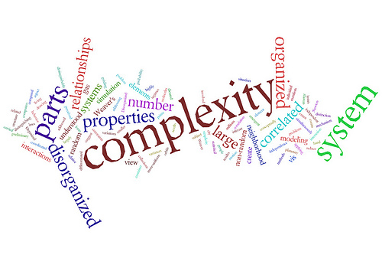
Beyond Theory in Terms of Rising Complexity
What does this really mean?
What makes things complex?
How do we measure complexity?
Notes:
But, getting back to the phase “Beyond theory in terms of rising complexity?”
What does this really mean. And, what makes something complex? And, how do we measure complexity? These are not necessarily easy questions to answer.
?

Slide 15
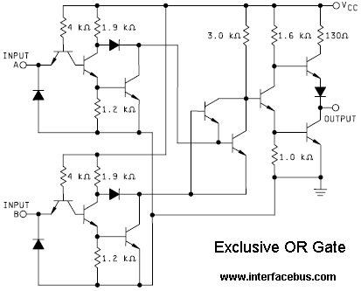
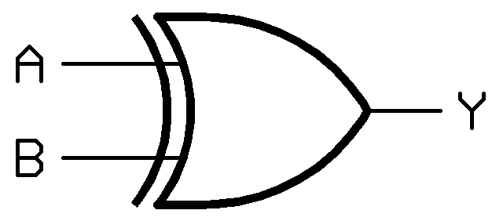
What Makes Something Complex?
System consisting of many interconnected parts
  Examining the individual parts tells you nothing about the system
Complex does not necessarily mean complicated
Notes:
I want to first try and answer the question, “what makes something complex?”
The general definition you will find on complexity is that it is something (for example, a system) that consist of many interconnected parts. The key point here is that examining the individual parts tells you nothing about the system as a whole.
As an example, I show a schematic here on the left hand of this slide for an exclusive OR gate. The schematic consist of a number of transistor, resistors, and diodes. By looking at the individual parts, you don't have a clue of what the overall behavior the combined parts is. To understand the overall behavior, it is necessary to understand the interconnections and interaction between these parts.
Now complexity does not necessarily mean complicated--it depends on the degree of interactions between parts. Also, complexity is not necessarily a bad thing. In fact, historically complexity has lead to innovation and automation—in order to reduce complexity. For example, the exclusive OR gate on the right hand side of the slide is an abstraction for the schematic on the left. The transistors and other components are still there—but the details have been abstracted away. There are less parts we have to deal with—which means this is less complex.
But let's get back to the claim that we are now beyond theory in terms of rising complexity. Let’s look at a few trends that are pointing to an increasing mount of integration, which is leading to more complex systems…

Slide 16
Designs are Getting More Complex
Process Geometry
Wilson Research Group and Mentor Graphics, 2012 Functional Verification Study, Used with permission
Notes:
The first trend I want to look at is the industry movement to smaller geometries. Here I show the adoption graphs for various geometrics between 2007 and 2012. I also show the mean calculation for these curves. Now, recall, the statistical “mean” is an average. In other words, about half of the designs fall below this point, and half the design above.
You can clearly see that the industry is adopting smaller geometries in their designs over time—where we found the mean to be about 45nm in 2012.

Slide 17
Designs are Getting More Complex
Number of gates of logic and datapath, excluding memories
Wilson Research Group and Mentor Graphics, 2012 Functional Verification Study, Used with permission
Notes:
Now, smaller geometries enable larger gate counts, and on this slide I am showing the trend in terms of gates counts over an 11 year period.
One thing we found from the study was about 1/3 of the study participants were working on designs less than 5M gates, 1/3 on designs between 5-20M gates, and 1/3 on designs greater than 20M gates.

Slide 18
Designs are Getting More Complex
Mean number of gates of logic and datapath, excluding memories trends
Wilson Research Group and Mentor Graphics, 2012 Functional Verification Study, Used with permission
Notes:
Here’s an easier way to look at the adoption trend, by examining the statistical mean from the previous graphs. Note that the dates between the study samples varies from 5, 3, and 2 years. Taking this into account, the mean adoption trends somewhat follows Moore’s Law, as you would expect.

Slide 19
Designs are Getting More Complex
79% of designs contain one or more embedded processors
Source: Wilson Research Group and Mentor Graphics, 2012 Functional Verification Study
Notes:
Now, let’s look at the trend in terms of the number of embedded processors on a chip. In other words, the emergence of SoC class designs.
We see today that 79% of all designs contain one or more embedded processors. But what makes these class of designs more complicated to verify is that we are now dealing with the interaction between hardware and software.
But note that 57% of all designs contain two or more embedded processors. Many of these multi-processor based designs share resources, such as memory—which brings about a whole new set of verification challenges related to cache coherency. You will learn a little bit more about coherency challenges later today in other talks.

Slide 20
Designs are Getting More Complex
Mean number of embedded processors continues to rise
Source: Wilson Research Group and Mentor Graphics, 2012 Functional Verification Study
Notes:
This slide shows the trend in terms of the mean number of embedded processors spanning over eight years. We did see on the previous slide that the 13% of the designs today have five or more embedded processors. Designs are getting more complex!
How many of you are working on a design with two or more embedded processors?
How many of you are working on a designs where multiple processors share the same memory resource and cache coherency is a concern?

Slide 21
FPGAs are Getting Complex Too!
56% of FPGAs contain one or more embedded processors
Wilson Research Group and Mentor Graphics, 2012 Functional Verification Study, Used with permission
Notes:
It’s not only IC and ASIC designs that are getting more complex, the same trend is happening in FPGA designs. For example, 56% of all FPGAs today contain one or more embedded processors. 18% of all FPGA designs contain two or more embedded processors.

Slide 22
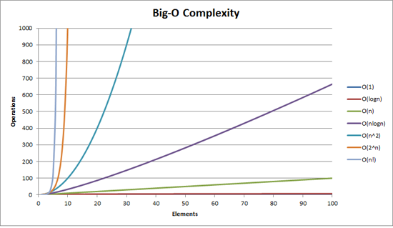
How do we measure complexity?
Computational complexity theory used in computer science
There are no generally accepted metrics!
O(1)
Operations
O(logn)
O(n)
O(nlogn)
O(n^2)
O(2^n)
O(n!)
Elements
Notes:
Now I want to move from the discussion of what makes designs complex, and address the other questions I asked earlier: How do we measure complexity?
This is an area of research for hardware designs. In general, there are no universally accepted metrics specifically related hardware complexity. But, isn't our real objective to determine if something is going to be complicated to verify?
In theoretical computer science, there is an area of study know as computation complexity, which I am sure most of you are familiar with. This is the Big-O characterization for algorithms in terms of time and space complexity. For example, order(n) or order(n^2).
There have been some attempts to characterize hardware complexity by running certain verification algorithms on a hardware design (for example, reachability related to model checking).The problem with this approach is that there are certain classes of designs that will inherently blow up for a specific verification algorithm. So, is the design really complex, or does this just characterize a limitation of an algorithm. This doesn’t help us if our goal is really trying to determine if a design is going to be complicated to verify.

Slide 23
Is bug density a good proxy?
Channel
Data Link Layer
Encoder
Decoder
TX
PHY
Compressed
Audio
RX
Single, sequential data streams
  Floating point unit
  Graphics shading unit
  DSP convolution unit
  MPEG decode
  . . .
Multiple, concurrent data streams
  Cross bar
  Bus traffic controller
  DMA controller
  Standard I/F (e.g., PCIe)
  . . .
Sequential data streams
1x number of bugs
Concurrent data streams
5x number of bugs
-Ted Scardamalia, internal IBM study
Notes:
Really, what we are interested in….is not so much measuring how complex the design is….but determining how complicated its going to be to verify. Perhaps, we should think about measurements related to this. So, let’s look at a number of different proxies to get a better understanding of what makes something complicated to verify.
First, let’s look at bug density. Now, this is a study conducted by IBM, which attempted to characterized bug escapes. What was looked at here, were the number of bugs found per 1000 gates of logic related to various classes of designs. They found that concurrent designs (in terms of multiple interacting data stream) had 5 time the number of bugs…versus designs that were more sequential in nature.
In fact, look at the designs I have listed in the box on the right hand side of this slide. These involve multiple concurrent data streams. I often hear various projects talk about the complex “corner cases” that they failed to think of…and therefore test for these designs. These untested corner cases allowed a bug to escapes. That’s the problem with concurrent behavior—it is often difficult to think of all the possible interactions that might occur. In fact, this is precisely why constrained-random and formal property checking are needed for this class of designs—since these technologies explore behaviors we never could dream of.
Now, for designs that are sequential in nature, corner cases are possible too. But generally, they are not complex in a Byzantine sense. That is, they don’t involve the exact alignment of multiple events spread out over time. To verify the class of designs in the left hand box, it is not so much thinking about complex “temporal” scenarios to test…we just need to get a lot of vectors through the verification process to cover the input space.
The point I am trying to make with this slide is that designs involving multiple, concurrent data streams are more complicated to verify, than designs that are sequential in nature.

Slide 24
Concurrency is Complicated to Verify
Packet-Based Design
Arbiter
Tx
Transaction
Layer Packet
Reformater
From
Fabric
Retry Buffer
To
PHY
Data Link
Layer Packet
Reformater
Rx
From Rx Channel
Notes:
As an example of a designs involving multiple, concurrent data streams…let’s look at the data link layer block for a design similar to the PCIe. Here we see packets arriving from the transaction layer on the left hand side of the slide, which flows through a transaction-layer packet processors (which reformats the packet) and then flows out to the PHY. The reformatted transaction packet is also stored in a return buffe…. in case there is a request to resend the packet.
Concurrently, we have packets arriving from the data link layer, which are reformatted in its packet processor, and then also flow out to the PHY.
Notice that there is an arbiter that arbitrates between transaction-layer packets, data link-layer packets, and retry request.
If we want to test this block, we have to think…not only the normal behavior to test…but we also need to think about its corner cases. For example, you might imagine a case where the retry buffer is full…a packet arrives from the transaction layer, and concurrently a packet arrives from the datalink layer, and also concurrently we get a retry request. Obviously, there are many complex ordering of events that must occur during our test to flush out this unique corner case bug.
So my point here is that as the interaction between multiple components increases in a design, it is no longer possible the think about all possible corner cases.

Slide 25
Maybe effort is a good proxy?
Critical
Threshold
Prohibitive
Cost/Effort
Expensive
Affordable
Complexity
Notes:
Perhaps we should look at effort as a proxy? Although, it seems to me that every paper published on verification for the past ten years makes the claim that “70% of the effort spent on a project is in verification.” Yet, I can’t seem to find anyone who knows the original source of this number—and if the number is just based on a gut feeling. Nonetheless, we can look at a few datapoints that have been quantified indirectly related to effort.

Slide 26
Verification Consumes Majority of Project Time
Wilson Research Group and Mentor Graphics, 2012 Functional Verification Study
Notes:
First, let’s look at the total project time spent in verification. You can see from these graphs that it is all over the spectrum…from some projects spending little time in verification, to others spending a significant amount of time in verification. We have seen the mean time increase since 2007, although the rate of increase might be slowing in the last two years. Nonetheless, more than half of a project’s total time is spent in verification.

Slide 27
More and More Verification Engineers
Mean peak number of design vs. verification engineers
~ 1-to-1 ratio
of peak design and verification engineers
58%
11%
Verification Engineers
4%
5%
Design Engineers
Source: Wilson Research Group and Mentor Graphics, 2012 Functional Verification Study
Notes:
Another data point we should look at is the mean peak number of design and verification engineers involved on a project. You can see that there has been a small increase in the mean peak number of design engineers over the past 5 years---keep in mind that designs have continued to increase in size at a Moore’s Laws rate. The mean peak number of verification engineers between 2007 and 2012 increased significantly. In fact, today we see the ration in terms of mean peak verification engineers to design engineers at about 1-to-1.

Slide 28
Where Verification Engineers Spend Their Time
Wilson Research Group and Mentor Graphics, 2012 Functional Verification Study, Used with permission
Notes:
Let’s now look at where verification engineers spend their time. Here we are looking at test planning, testebench development, creating and running test, debug and other task. Note that verification engineers spend most of their time (which is, 36%) in debug. Here we are talking about debugging both the design and testbench.

Slide 29
Designers Doing More and More Verification
Time Design Engineers Spend on
Verification vs. Design
Design Engineer Project Time
2007 - 2012
54%
53%
15% Increase
47%
46%
2007
2012
2007
2012
Doing Design
Doing Verification
Source: Wilson Research Group and Mentor Graphics, 2012 Functional Verification Study
Notes:
The next data point we should look at is the amount of time that a design engineer spends actually doing design, versus involved in the verification process. Keep in mind that if a verification engineer drags a designer into the debug process—then the design engineer is spending time in verification.
You can see, today, that the design engineer actually spends more time involved verification than they do in actual design. In fact, the amount of time spent in verification has increase by 15% within the last 5 years.

Slide 30
Time Designers Spends in Design vs. Verification
At this rate…
  In 25 years, ALL of a designer’s time will be devoted to verification
Time (Percent)
Time Design Engineers Spends Doing:
Design
Verification
Project Time 2007 - 2037
Notes:
At this rate of increase, you would find that in 25 years all of a designer’s time would be spent in verification, and no time in design!

Slide 31
Design Reuse Trends
Source: Wilson Research Group and Mentor Graphics.

Slide 32
Verification Reuse
Mean testbench composition trends
Wilson Research Group and Mentor Graphics, 2012 Functional Verification Study, Used with permission
Notes:
Speaking of VIP, let’s look at the trends in terms of verification reuse. Between 2007 and 2012, comparing the mean calculations, we saw a 22% decrease in code being written to create testbenches…..and also we saw a 112% increase in externally acquired VIP. A lot of this has been driven by internal and external bus standards, and we are starting to see higher forms of verification IP that is is targeted at subsystems today.

Slide 33

With All This Effort, How are We Doing?
Notes:
Now, so with all this effort being spent in verification, we should ask the question, “How are we doing as an industry?” In other words, are we swimming, sinking, or just trading water?

Slide 34
Project’s Schedule Completion Trends
Ahead of schedule
Behind Schedule
Source: Wilson Research Group and Mentor Graphics, 2012 Functional Verification Study
> 10% Early
10% Early
On-Schedule
10% Behind
20%
30%
40%
50%
> 50% Behind
Notes:
Let’s first look and see where the industry is in terms of meeting schedule. We found that about 1/3 of the industry meets or beats their originally planned schedule, while 2/3 of the industry is behind schedule. You could look at the results two ways: (1) The industry has been consistently poor at meeting their originally planned schedule over the past 5 years. (2) Even though designs are getting larger at a Moore’s Law rate, the industry isn’t getting any worst. Hence, it is terading water with increased complexity.

Slide 35
FPGA vs. Non-FPGA Completion Trends
Wilson Research Group and Mentor Graphics, 2012 Functional Verification Study, Used with permission
Notes:
Now, as I previously stated, FPGA designs are getting increasingly more complex—where we saw 56% of all FPGA now have embedded processors. Here I am comparing FPGA vs Non-FPGA designs, and you can see that FPGA projects are no better than the Non-FPGA projects in terms of meeting their originally planned schedule.

Slide 36
Required Number of Spins
Wilson Research Group and Mentor Graphics, 2012 Functional Verification Study, Used with permission
Notes:
Next, let’s look at the number of required spins from first tapeout until volume production. Now, to be fair, many projects often plan 2 or more spins in until final productions, so first silicon success might not be their original goal.
Nonetheless, noticed that first silicon success has remained around 30% for the past 8 years, where in 2012 it was 33%. Also note that second silicon success seems to have improved over the past eight years while more than two required spins appears to be decreasing.

Slide 37
Types of Flaws
Wilson Research Group and Mentor Graphics, 2012 Functional Verification Study, Used with permission
* Multiple answers possible
Notes:
This slides shows various categories of flaws that are contributing to respins. You might note that the sum is greater than 100% on this graph. The reason is that multiple flaws are possible that result in a respins.
Although Logic and Functional flaws remains the leading cause of respin, there has been improvement in this area over the past eight years. This is likely due to the increased amount of reuse that is occurring in the industry, as well as the industry maturing its verification processes—which I’ll talk about in a few minutes.
Clocking issues are the second leading cause of respins. Notices in 2012 that there seems to be an increase in crosstalk, power consumption, and mix-signal issues.

Slide 38
Root Cause of Functional Flaws
Wilson Research Group and Mentor Graphics, 2012 Functional Verification Study, Used with permission
* Multiple answers possible
Notes:
The previous slide list flaws that contributed to respins, and we saw that functional flaws was the leading category. To improve processes, it’s important to understand the root cause of these flaws.
This slide list the root cause of functional flaws by various categories, such as: design errors, changes in specification, incorrect or incomplete specification, internal IP flaws associated with reuse, and external IP flaws.
I think it is interesting to note the various flaws associated with either changes or incorrect specification. Managing and tracking specification requirements has grown more important over the past 11 years, as design sizes increase, and newer aspects of functional verification are now required (such as power intent and clocking).

Slide 39
Cost of Find Functional Flaws
Silicon Debug, Doug Josephson and Bob Gottlieb, (Paul Ryan)
D. Gizopoulos (ed.), Advances in Electronic Testing: Challenges and Methodologies, Springer, 2006
Notes:
Now, a few slides back, I showed the cost/effort curve associated with increased complexity. There is another dimension to the problem that needs to be discussed when making a tradoff on where to focus your verification effort.
At any stage within the verification flow, when a bug is found, I always recommend the verification team to ask themselves the question: “Should or could this bug have been found earlier in a previously stage of the flow?” For example, block-level or sub-system-level versus SoC Integration level. There is always that tradeoff in terms of how much effort should be applied to a particular stage of the verification flow that needs to be considered. The more automation that can be applied in any stages within the flow, the smaller amount of effort that is required, and less bug escapes occur to the next level of integration.
This slide illustrates the cost of finding and fixing bugs that escape from one stage of the design flow, to the next. The sooner you can find a bug....the cheaper it is to fix. You hear the theme in the various talks today.

Slide 40
Beyond Standards
Beyond arguing over who won the standards war
Notes:
The next section of my talk, I’ve titled Beyond Standards…and the point I want to make in this section is that arguing over who one the standards wars is not constructive. We live in a multi-language world. The important thing to understand is where the eco system evolving in terms of acquired expertise, tools, and IP related to these standards.

Slide 41
Standardization of Languages
Source: Wilson Research Group and Mentor Graphics, 2012 Functional Verification Study
Notes:
First, let’s look at the adoption of languages used for verification. In other words, languages used to construct simulation testbenches. Basically we are seeing a decline in all languages used to construct testbenches, with the exception of SystemVerilog standard, and a some increase in C/C++.

Slide 42
SystemVerilog Adoption by Design Size
Source: Wilson Research Group and Mentor Graphics, 2012 Functional Verification Study
Notes:
This slide presents the data in a slightly different perspective. Here the study participants were partitioned into subgroups by design sizes <5M gates, between 5-20M gates, and >20M gates. For designs larger than 20M gates, it’s not too big of a surprise to see large adoption of SystemVerilog, since this group (in general) tends to be a little more leading edge on adopting more advanced functional verification techniques. What is a surprise is the group less than 5M gates. The fact the we are seeing a 58.8% percent adoption in this group means that SystemVerilog is now mainstream.

Slide 43
Standardization in Base Class Libraries
Source: Wilson Research Group and Mentor Graphics, 2012 Functional Verification Study
Notes:
Now, let’s look at the adoption of verification testbench methodologies—or base-class library standards. Again, we are seeing a decline in usage of all base-class library standards, with the exception of UVM. Between 2010 and 2012 we saw a 486% increase in adoption of UVM. To be fair, UVM wasn’t really an official an Accellera standard in 2010 when that study was conducted—there was only a beta kit available. Nonetheless, the 2012 study asked its participants what they plan to use in the next 12 months, and there is a projected growth of 46% within the next year.
Clearly, the standards wars are behind us, and the industry has moved on focusing on the evolving eco system based on these standards.

Slide 44
Standardization of the SoC Verification Process
Ten years ago, IC/ASIC verification was partitioned into two main steps:
Block Full Chip
Block-Level
Verification
Integration
Verification
Notes:
Besides, languages and base-class library standards, we have recently seen the emergence of a consistent approach to SoC verification.
First, let’s look and see how the IC/ASIC flow has evolved into today’s SoC flow. Ten years ago, the IC/ASIC verification flow was partitioned into two main stages: Block-level verification, and integration verification. In general, there was less of a concern with verifying software/hardware interactions 10 years ago. Nor were there concerns with many other issues that exist today, such as multiple clock domains, and power intent verification.

Slide 45
Standardization of the SoC Verification Process
Emerging from ad hoc to systematic processes
IP Subsystem SoC System
Block-Level
Verification
Interconnect
Verification
Integration
Verification
Application / SW
Verification
Notes:
As SoC designs became more prevalent within the past 5 years or so, we saw many ad hoc verification processes emerged. However, recently, we have seen these ad hoc processes converge into a more systematic approach to verifying an SoC. The processes is generally partitioned into four stages, as I’ve shown on this slide: block-level verification, interconnect verification, integration verification, and application / SW verification—although some companies further partition these main four stages down into sub-stages. In a few minutes, I’ll talk a little bit more about each of these four main stages.
If you recall in the previous section, I introduced a slide that showed how the cost of fixing a bug increased by about 10x from one stage of a process to the next. The objective with this standard SoC verification process is to reduce the cost of finding and fixing bugs. For example, it’s significantly more costly to find and fix a bug during integration verification that should have been found during a previous stage—such as interconnect verification or block-level verification.
The point that I want to make here is that a recent standards have emerged within the last 10 years (and an eco system based on these standards) that allow us to now focus on the solving problems from a holistic perspective on this new SoC verification process.

Slide 46
Beyond the status quo
Beyond surviving by maintaining the status quo
Notes:
The final topic I want to focus on today I’ve titled “Beyond the status quo.” The key take away in this section is that in today’s complex SoC world, it’s no longer possible to survive by maintaining the status quo.

Slide 47
The Verification Paradox
A good verification process lets you get the most out of best-in-class verification tools
Start
Tools
Ad Hoc Processes
6-9%
Cost Increase
Start
Process
Tools
20-30%
Cost Savings
Source: Cisco Momentum Research Group
Notes:
The reason I focus on this emerging process, is that a process is fundamental to achieving productivity and getting the most out of the tools you adopt.
On this slide, I am showing a study that was conducted by Cisco Research Momentum group. This study was focused on understanding barriers to productivity. What they found was that organizations that focused on tools first, and then put in place ad hoc processes to support those tools ended up increasing cost between 6-9%. Versus organizations that focused on the process first, and then put in place tools to support the process, ended up saving cost between 20-30%. Furthermore, these organizations were able to achieve their goal of improving productivity.

Slide 48
Standardization of the SoC Verification Process
Block-Level
Verification
Interconnect
Verification
Integration
Verification
Application / SW
Verification
Notes:
I now plan to dig a little bit deeper into each of the four stages of the standard SoC verification process I just introduced.
The first stage of the standard SoC verification process is focused on block-level verification. This is essentially IP verification. An interesting trend that has recently emerged is that the industry (as a whole) appears to be maturing its verification processes applied at this stage in the process—supporting my claim that it is not possible to “survive by maintaining the status quo” for today’s complex SoC designs. For example…..

Slide 49
Use of Advanced Verification Techniques
Source: Wilson Research Group and Mentor Graphics, 2012 Functional Verification Study
Notes:
Here we see a significant increase in adoption of various verification techniques within the last 5 years…where code coverage adoption has increase from 48% to 70%....assertions used in simulation has increased from 37% to 68%...functional coverage has increased from 40% to 71%...and constrained-random simulation has increased from 41% to 62%. There appears to be a leveling off or possible saturation in terms of adoption within the past two years…but nonetheless…these are impressive increases since 2007. I believe that the industry had been forced to mature its processes to address rising complexity.

Slide 50
Directed vs Constrained-Random Simulation
16% Increase
Wilson Research Group and Mentor Graphics, 2012 Functional Verification Study, Used with permission
Notes:
Let’s look a little closer at constrained-random simulation. If you recall, I talked about bug density earlier and the need for techniques to address concurrent data paths. Constrained-random is one of those effective techniques that can be applied on concurrent designs.
We have seen a 16% increase use of constrained-random over directed testing for block-level verification within the past two years. Part of this is due to the maturing of various industry standards, such as SystemVerilog and UVM—which facilitate the creation of constrained-random testbenches.

Slide 51
Larger Designs Use More Formal
Source: Wilson Research Group and Mentor Graphics, 2012 Functional Verification Study
Notes:
Another indication that the industry is moving “beyond the status quo” and maturing its processes…is the adoption of formal-based technologies into the flow. Here we see, the larger the design size, the more adoption of formal techniques into the flow.

Slide 52
The Evolution of Formal Technology
High
Effort
Formal
Property
Checking
Automated
Applications
Fully
Automatic
Formal
Low
Effort
1990s
2000s
Today
Formal
Experts
Everyone
Notes:
Formal property checking adoption in the industry can be traced back to a handful of advanced processor company’s back in the early 1990’s. The languages used to describe assertions and the tools used to prove these assertions all originated from academia. Hence, there was a big learning curve and high expertise required for successful adoption. In general, only formal experts with PhDs could apply these techniques. There was a huge investment required in terms of both expertise and time. The industry adoption rate was extremely low—as I previously mention, only the large processor companies could afford to invest in this type of research and expertise.
By early 2000, automated applications began to appear. Essentially, this is narrowing the scope of formal property checking to focus on solving a specification problem domain—such as validating correct Interconnect, which we will see an example in a minute. The key point is that the engineering adopting this form of formal analysis didn’t have to be an expert in formal tools or general assertion languages. Semiautomatic techniques could generate a set of assertions off of a users speadsheet—therefore the engineer didn’t have to be an expert in assertions languages.
What we see emerging today is fully automatic formal solutions. You can think of this as
- Push-button formal
Assertions inferred – under the hood – user is shielded from them
Easy for everyone to use with low effort

Slide 53
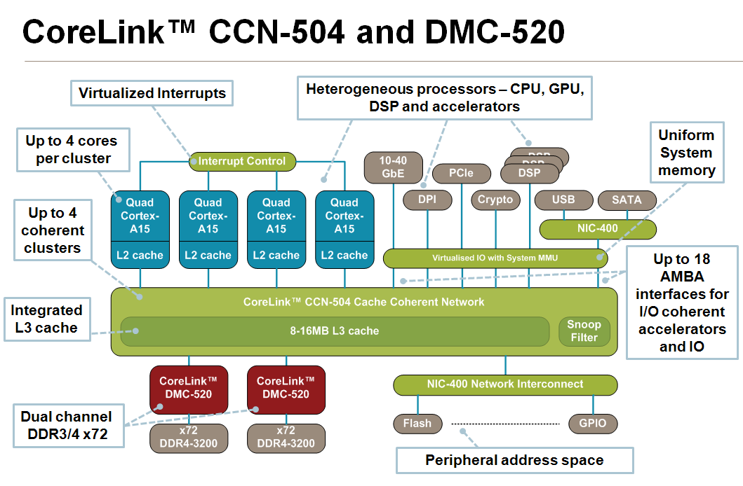
Standardization of the SoC Verification Process
Block-Level
Verification
Interconnect
Verification
Integration
Verification
Application / SW
Verification
A57
A57
A57
A57
Notes:
But the next stage I want to talk about is the interconnect verification stage of today’s SoC verification process. Now, interconnect is not simply a wire-to-wire connection with potentially some muxes through the path. Today’s interconnect often involves a lot of logic—and a lot of IP. Our invited speaker, Ashley Stevens from ARM, will talk after lunch today about the new AMBA® 5 CHI (Coherent Hub Interface). You’ll here more about interconnect verification and the importance of VIP later today from Steve Bailey.

Slide 54
Standardization of the SoC Verification Process
Block-Level
Verification
Interconnect
Verification
Integration
Verification
Application / SW
Verification
    IP Blocks connectivity
    Access all memories
    Access all registers, such as control
    Configurations work
    Functional scenarios and use-cases
    Verify multiple clock domain crossings
Notes:
The next stage of the SoC Verification Process involves Integration Verification. The first step of verification is to ensure that all the IP blocks are connected correct. In other words, you don’t want to waste cycles running functional scenarios or use cases only to learn that the IP blocks are not connected correctly. This connectivity verification is not a simple point to point check. The connections can vary under different modes—and this needs to be check. Formal-based techniques are often used here since they are exhaustive and complete—and, since the formal techniques are automated, they require signification less work than verifying connectivity through writing a set of directed test.
After the connectivity checking, we need to verify that the processors(s) can properly access all control registers and memories—and that the SoC can be confifured properly. Again, we don’t want to find these types of problems when running use-cases—since it is more expensive to find and fix these bugs later on.
Clock domain crossing verification is also necessary at this stage as we integrate multiple IP blocks. In fact, let’s look at some data related to multiple asynchronous clock domains found in today’s designs.

Slide 55
Mean Number of Clock Domains by Design Size
Source: Wilson Research Group and Mentor Graphics, 2012 Functional Verification Study
Notes:
Here we see that mean number of clock domains partitioned by design size, from <5M gates, 5-20M gates, and >20M gates. Not too big of a suppress…the larger the design, the more IPs with their own clocking and power requirements…..the more clock domains.

Slide 56
Standardization of the SoC Verification Process
Block-Level
Verification
Interconnect
Verification
Integration
Verification
Application / SW
Verification
    Boot OS
    Load System Drivers
    Run Application SW
Notes:
The final stage in the SoC Verification Process focuses on software verification and verifying that the SoC application is functioning as intended.

Slide 57
SoC Design & Verification Involves Lots of SW
It’s the software, stupid! -Gary Smith
($ M)
Source: ITRS 2010, Impact of Design Technology on SoC Consumer Portable Implementation Cost
Notes:
Today, as you know, SoC design involves a lot of software. On this slide I am showing the ITRS 2010 report where they track the total SW engineering cost + ESA tools, and the total HW engineering cost + EDA tooks for a typical SoC consumer product. It’s interesting to note that software hardware cost has basically remained flat over the past 12 years—while software cost are skyrocketing! As Gary Smith says: It’s the software, stupid!
Verifying the software component of the SoC (from device drivers, firmware, OS, middleware, and on and on).

Slide 58
As Design Sizes Increase…Emulation Up, FPGA Prototyping Down in 2012
Source: Wilson Research Group and Mentor Graphics, 2012 Functional Verification Study
Notes:
What we did was partition the data by design sizes <5M gates, 5-20m gates, and >20M gates. What we found was the as design increase above 20M gates….the use of FPGA prototyping seems to decline. This is likely due to the effort required to partition the design across multiple FPGAs, which introduces artificial latencies into the design and can present some additional challenges when developing software.

Slide 59

Integrated Simulation/Emulation/Software Verification Environments Emerge
Design under Test
Testbench
Acceleration
System Level
OVM/UVM
SystemC/C++
Virtual Prototype
Monitors
SW Debug
Processor Debug
Assertions & Checkers
JTAG
Protocol Solutions
Protocol Solutions
Virtual Devices & Transactors
Physical Devices
Notes:
Early generations of emulators were essentially a single user platform, housed in a special room with tons of physical devices. Today’s generation of emulators, such as the Veloce II, are much more functional—supporting virtual devices, and allowing multiple users access to the platform for SW development and debug.

Slide 60
Coverage and Power
Across all aspects of verification
Block Subsystem SoC System
Block-Level
Verification
Interconnect
Verification
Integration
Verification
Application / SW
Verification
Notes:
One other trend that has emerged today is that coverage measurements and power verification occurs across all aspects of this newly emerged SoC Verification process or flow.

Slide 61
The Rising Importance of Coverage
Signoff criteria trends
Wilson Research Group and Mentor Graphics, 2012 Functional Verification Study, Used with permission
* Multiple answers possible
Notes:
In fact, related to coverage, we see a shift in their importance within the last 5 years. This graph shows various signoff criteria that is used to gate tapeout today. Notice that there has ben a decline in terms of importance on all other signoff criteria with the exception of achieving coverage targets.

Slide 62
Unified Coverage Interoperability Standard
New Accellera UCIS Standard Announced at DAC 2012
Formal
Simulation
Emulation
UCIS API
Coverage Database
Analysis
Testplan

Slide 63
Trends in Power Management Verification
67% of the industry actively
manages power
Source: Wilson Research Group and Mentor Graphics, 2012 Functional Verification Study, Used with permission
Notes:
Let’s begin by looking at the effort involved in verification—and the results in terms of industry success.

Slide 64
Power Trends
Wilson Research Group and Mentor Graphics, 2012 Functional Verification Study, Used with permission

Slide 65
Power Trends
Wilson Research Group and Mentor Graphics, 2012 Functional Verification Study, Used with permission

Slide 66
Power Trends
Notation used to describe power intent
* Multiple answers possible
Source: Wilson Research Group and Mentor Graphics, 2012 Functional Verification Study, Used with permission
Notes:
Let’s begin by looking at the effort involved in verification—and the results in terms of industry success.

Slide 67
Beyond the Status Quo
Standardization of the SoC Verification Process
IP Subsystem SoC System
Block-Level
Verification
Interconnect
Verification
Integration
Verification
Application / SW
Verification

Slide 68
Back to the future
The Productivity Gap
Notes:
The final topic I want to focus on today I’ve titled “Beyond the status quo.” The key take away in this section is that in today’s complex SoC world, it’s no longer possible to survive by maintaining the status quo.

Slide 69
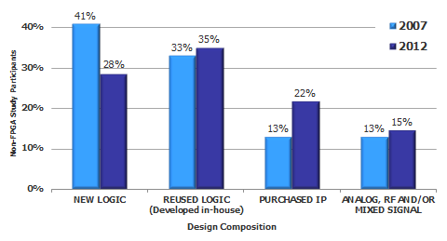
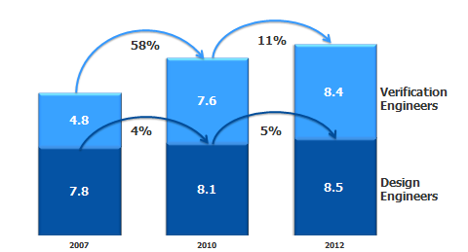
Design Productivity Gap
Silicon
Density
Capacity
Design
Productivity
Time
Source: SEMATECH
Notes:
Silicon capacity grows at 58% / year. Design productivity grwos at 21% per year.
So, what’s the solution to this increasing verification gap trend? Well, like the design productivity gap, reuse will certainly help. Yet, verification reuse by itself will not be enough to solve this problem.

Slide 70
Verification Productivity Gap
Silicon
Density
Capacity
Design
Productivity
Verification
Productivity
Time
Source: SEMATECH
Notes:
Silicon capacity grows at 58% / year. Design productivity grwos at 21% per year.
So, what’s the solution to this increasing verification gap trend? Well, like the design productivity gap, reuse will certainly help. Yet, verification reuse by itself will not be enough to solve this problem.

Slide 71




Closing The Verification Gap
?
Reuse
Abstraction
Acceleration
Methodology
71
Notes:
I believe that the solution lies in the combination multiple strategies—which include reuse, acceleration, abstraction, and methodology. In fact, it’s this combination of these strategies that form the foundation of Mentor’s verification solutions—and the focus of today’s seminar.
Presentation Title

Slide 72

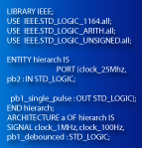
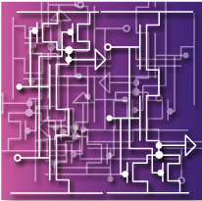
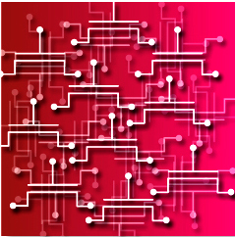
Managing Complexity
#include "systemc.h" SC_MODULE(adder) // module (class) declaration { sc_in<int> a, b; // ports sc_out<int> sum; void do_add() // process { sum = a + b; } SC_CTOR(adder) // constructor { SC_METHOD(do_add); // register do_add to kernel sensitive << a << b; // sensitivity list of do_add } };
100s of lines
of TLM
Millions of
Lines of RTL
100s of Millions of Gates
Billions of Transistors
72
Notes:
Abstraction level steps come every 15 to 20 years, with substantial overlap.
When I joined the semiconductor industry, engineers had finally developed confidence in using SPICE simulations at the transistor level
By the 1980’s, gate level simulation began to penetrate design flows and gate level hardware accelerators began to emerge
In the 1990’s, RTL (Verilog and VHDL) began to achieve broad adoption
The next step will be transaction level modeling and verification and we are overdue.
Each of us can assume that we are good for three levels of abstraction in our careers. Those of us who started with transistors can expect to become comfortable with TLM within one career
(For each abstraction, we have to give something up to gain the 10X-100X+ speed increase.
At gate level, we threw away the details of transistor operation and assumed that someone who implemented the physical design would take care of that.
At RTL level, we assumed synchronous design and threw away timing information, assuming that someone would take care of the insertion of timing when they automatically generated a gate-level representation through logic synthesis
At transaction level, we’re likely to throw away detailed information on how blocks of the design communicate with one another and just assume that information packets will instantaneously move between blocks. Someone can insert the compression of that data into serial bit streams and the decompression in a later, automated stage of the design)

Slide 73
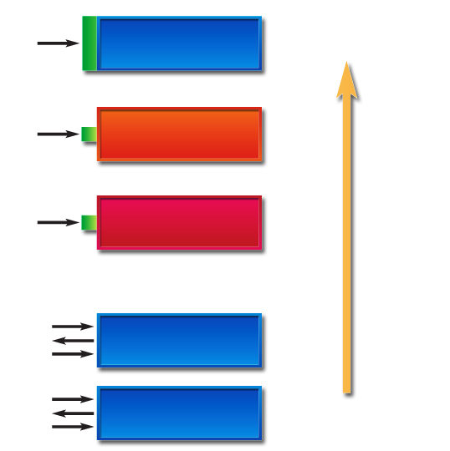
Productivity Gains Through Abstraction
Simulation
Function
arguments
C/C++
10,000x (1 min)
Untimed TLM
Transaction
1,000x
Timed TLM
Transaction
100x
clk
Cycle Accurate
Protocol
10x
clk
RTL
1x (7 days)
Protocol
73
Notes:
So how is TLM going to impact that need for 10X-100X+ improvement? It already has begun.
Mixed language simulators already include the ability to simulate at higher levels of abstraction. And special purpose tools are available for even higher levels of abstraction that can drive simulation speed to 10,000X or more when compared to RTL simulation in Verilog or System Verilog.
Verification IP will automatically synthesize the abstraction adaptation layers

Slide 74
Bug Prevention vs. Bug Hunting
What’s the advantage of SystemC compared with RTL?
There are two different aspects – quality and time schedule. Today, a full chip on SystemC will run around 10 MHz, and you will never reach that speed using RTL or a lower-level abstraction. It’s similar to a prototype speedup. Previously with RTL designs, our bug rate was in the range of 10 to 50 bugs per square millimeter. Now we are at less than one bug per millimeter squared. So we have both quality and speed of development.
Source: EETimes, 2007, Laurent Ducousso, who manages intellectual-property (IP) verification for STMicroelectronics’ Home Entertainment Division
Notes:
- Abstraction fundamental to improved quality and schedule
- It’s more efficient to prevent bugs than to find them
Presentation Title

Slide 75

Summary
Beyond theory in terms of rising complexity
Beyond arguing over who won the standards wars
Beyond surviving by maintaining the status quo

